Slide 1
SEMANTIC IMAGE SEGMENTATION WITH DEEP CONVOLUTIONAL NETS AND FULLY CONNECTED CRF
Published as a conference paper at ICLR 2015

Slide 2
Contents
Introduction
Related Work
Convolutional Neural Networks for Dense Image Labeling
Efficient Dense Sliding Window Feature Extraction with The Hole Algorithm
Controlling The Receptive Field Size and Accelerating Dense Computation with Convolutional nets
Detailed Boundary Recovery: Fully-Connected Conditional Random Fields and Multi-scale Prediction
Deep convolutional networks and The Localization Challenge
Fully-Connected Conditional Random Fields for Accurate Localization
Multi-Scale Prediction
Experimental Evaluation
Discussion

Slide 3
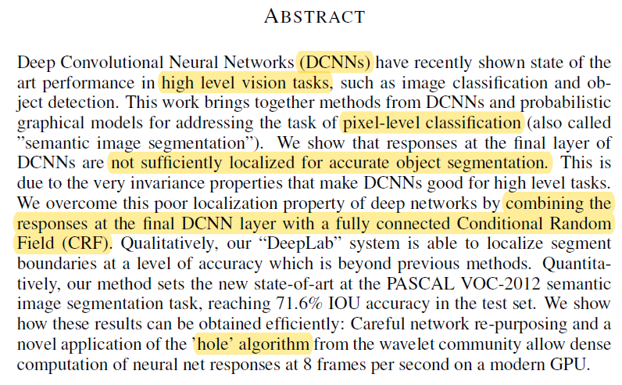
Abstract
DCNN : have shown SOTA in high level vision tasks(image classification, object detection)
Not sufficiently localized for accurate object segmentation
→ combining CRF
PASCAL VOC-2012 : 71.6% IOU
DCNN → ‘hole’ algorithm

Slide 4
1. Introduction
DCNN
mainstream of high-level vision research (image classification, object detection
trained in an end-to-end manner deliver
partially attributed to the built-in invariance of DCNNs to local image transformations → it can hamper low-level tasks
two technical hurdles in the application of DCNNs
signal downsampling
spatial ‘insensitivity’ (invariance)

Slide 5
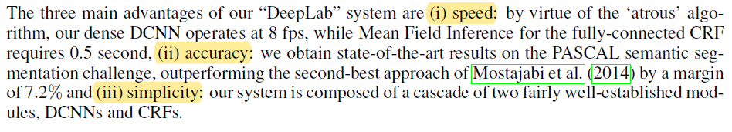
1. Introduction
The first problem relates to the reduction of signal resolution
repeated combination of max-pooling and downsampling (‘striding’)
we employ the ‘atrous’ (with holes) algorithm (efficient dense computation)
The second problem : invariance to spatial transformations
employing a fully-connected Conditional Random Field (CRF)
ability to capture fine edge details
Three main advantages of our “DeepLab” system
Speed
Accuracy
simplicity

Slide 6
2. Related Work
Our system works directly on the pixel representation
contrast to the two-stage approaches that are now most common in semantic segmentation with DCNNs
The main difference between our model and other state-of-the-art models is the combination of pixel-level CRFs and DCNN-based ‘unary terms’

Slide 7
3. CONVOLUTIONAL NEURAL NETWORKS FOR DENSE IMAGE LABELING
Imagenet pretrained state-of-art 16-layer classification network of (Simonyan & Zisserman, 2014) (VGG-16)
- how we have re-purposed and fine tuned

Slide 8
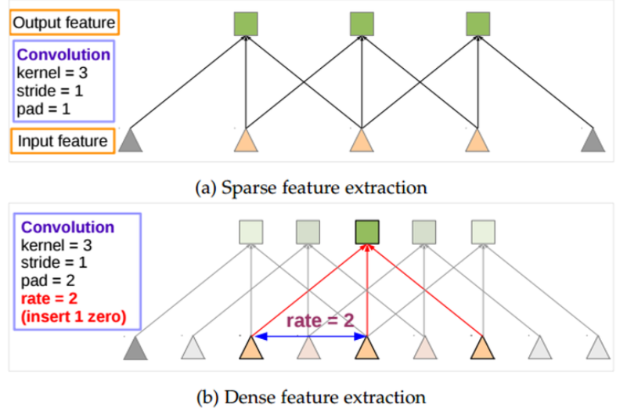
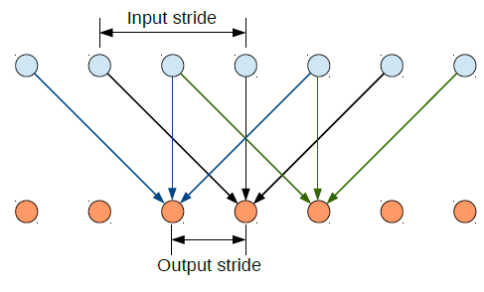
3.1 EFFICIENT DENSE SLIDING WINDOW FEATURE EXTRACTION WITH THE HOLE ALGORITHM

Slide 9
3.1 EFFICIENT DENSE SLIDING WINDOW FEATURE EXTRACTION WITH THE HOLE ALGORITHM
skip subsampling after the last two max-pooling layers in the network of Simonyan & Zisserman (2014)
modify the convolutional filters in the layers that follow them by introducing zeros to increase their length (2x in the last three convolutional layers and 4x in the first fully connected layer)

Slide 10
3.1 EFFICIENT DENSE SLIDING WINDOW FEATURE EXTRACTION WITH THE HOLE ALGORITHM
We finetune the model weights of the Imagenet-pretrained VGG-16 network
1000-way Imagenet classifier --> 21-way one
loss function : sum of cross-entropy
Optimize : standard SGD procedure

Slide 11
3.2 CONTROLLING THE RECEPTIVE FIELD SIZE AND ACCELERATING DENSE COMPUTATION WITH CONVOLUTIONAL NETS
VGG-16 net (large receptive field size)
receptive field : 224 X 224 (with zero-padding) and 404 x 404 pixels if the net is applied convolutionally
the first fully connected layer : 4,096 filters of large 7 x 7 spatial size
Our model
receptive field : 128 X 128 (with zero-padding) or 308 x 308 (in convolutional mode)
the first fully connected layer : 1,024 filters
the first FC layer to 4 x 4 (or 3 x 3) spatial size

Slide 12
4. DETAILED BOUNDARY RECOVERY: FULLY-CONNECTED CONDITIONAL RANDOM FIELDS AND MULTI-SCALE PREDICTION
4.1 DEEP CONVOLUTIONAL NETWORKS AND THE LOCALIZATION CHALLENGE
to harness information from multiple layers in the convolutional network in order to better estimate the object boundaries
to employ a super-pixel representation

Slide 13
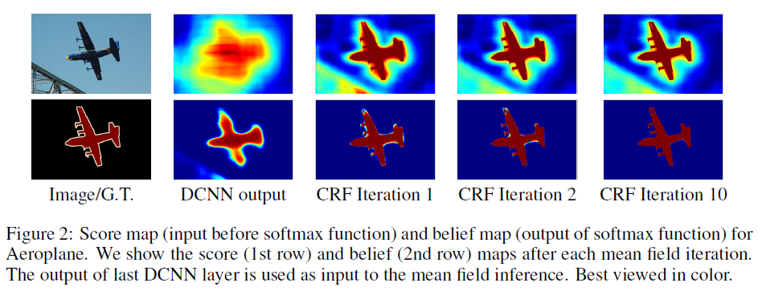
4.2 FULLY-CONNECTED CONDITIONAL RANDOM FIELDS FOR ACCURATE LOCALIZATION

Slide 14
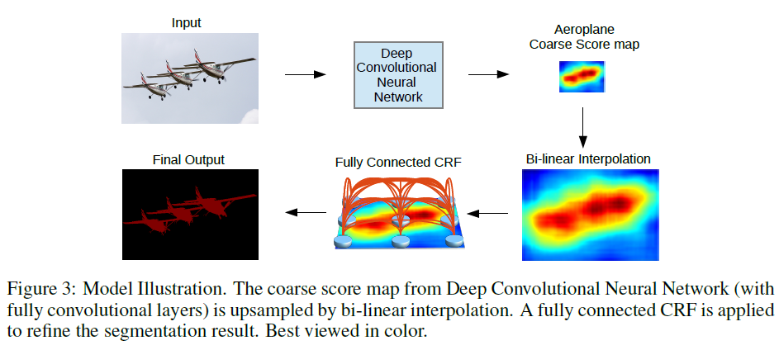
4.2 FULLY-CONNECTED CONDITIONAL RANDOM FIELDS FOR ACCURATE LOCALIZATION

Slide 15
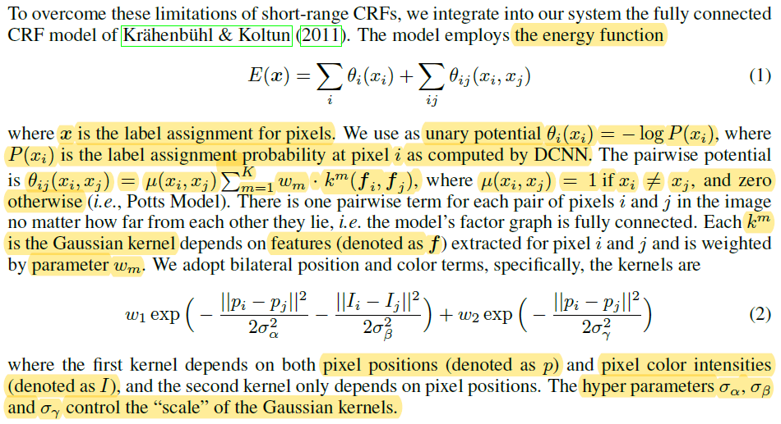
4.2 FULLY-CONNECTED CONDITIONAL RANDOM FIELDS FOR ACCURATE LOCALIZATION

Slide 16
4.3 MULTI-SCALE PREDICTION
explored a multi-scale prediction method to increase the boundary localization accuracy
we attach to the input image and the output of each of the first four max pooling layers a two-layer MLP (first layer: 128 3x3 convolutional filters, second layer: 128 1x1 convolutional filters)
feature map fed into the softmax layer is thus enhanced by 5 * 128 = 640 channels

Slide 17

5. EXPERIMENTAL EVALUATION
Dataset
PASCAL VOC 2012, consisting of 20 foreground object classes and one background class
Training
VGG-16 network (pre-trained on ImageNet)
mini-batch of 20 images, initial learning rate of 0.001 (0:01 for the final classifier layer), multiplying the learning rate by 0.1 at every 2000 iterations.
momentum of 0.9, weight decay 0.0005
Field of View (arbitrarily control the FOV)

Slide 18
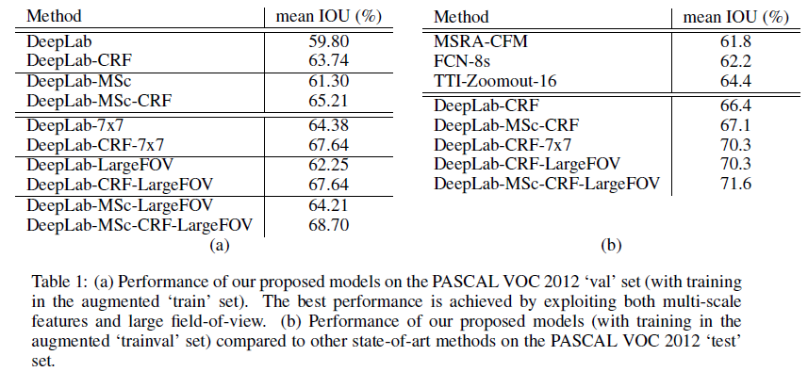
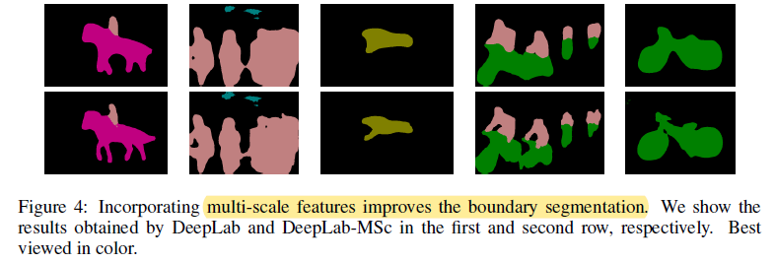
5. EXPERIMENTAL EVALUATION

Slide 19
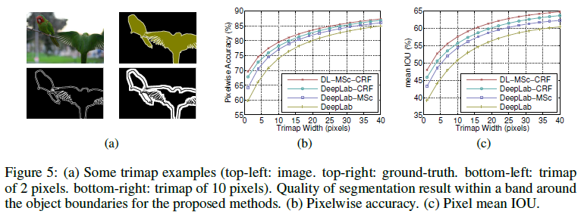
5. EXPERIMENTAL EVALUATION
Mean Pixel IOU along Object Boundaries
exploiting the multi-scale features from the intermediate layers
refining the segmentation results by a fully connected CRF

Slide 20
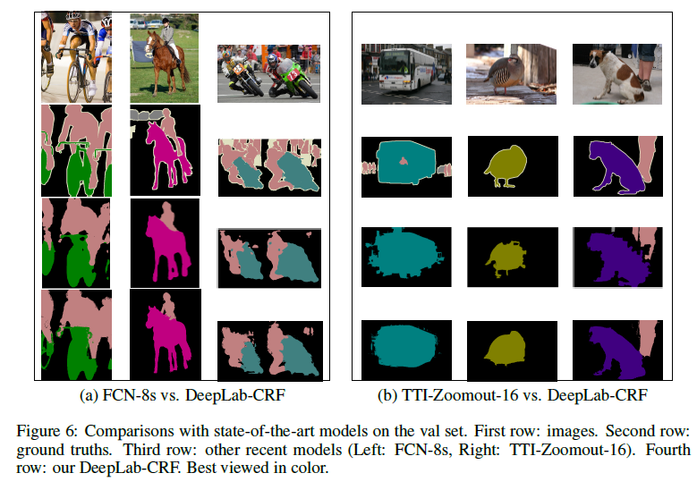
5. EXPERIMENTAL EVALUATION
Comparison with State-of-art

Slide 21
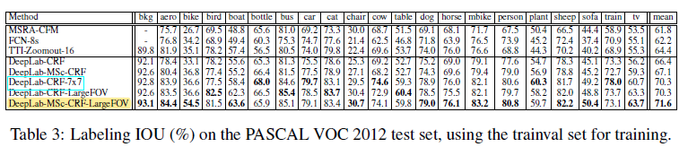
5. EXPERIMENTAL EVALUATION
Test set results

Slide 22
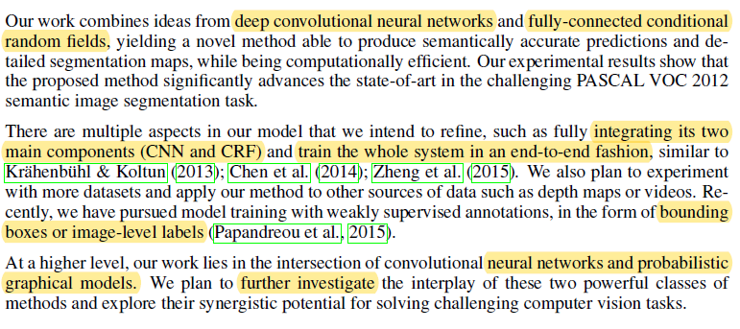
6. DISCUSSION

Slide 23
Thank you for your attention
Notes:
-이것으로 저널 발표를 마치겠습니다. 감사합니다

